Slide 1
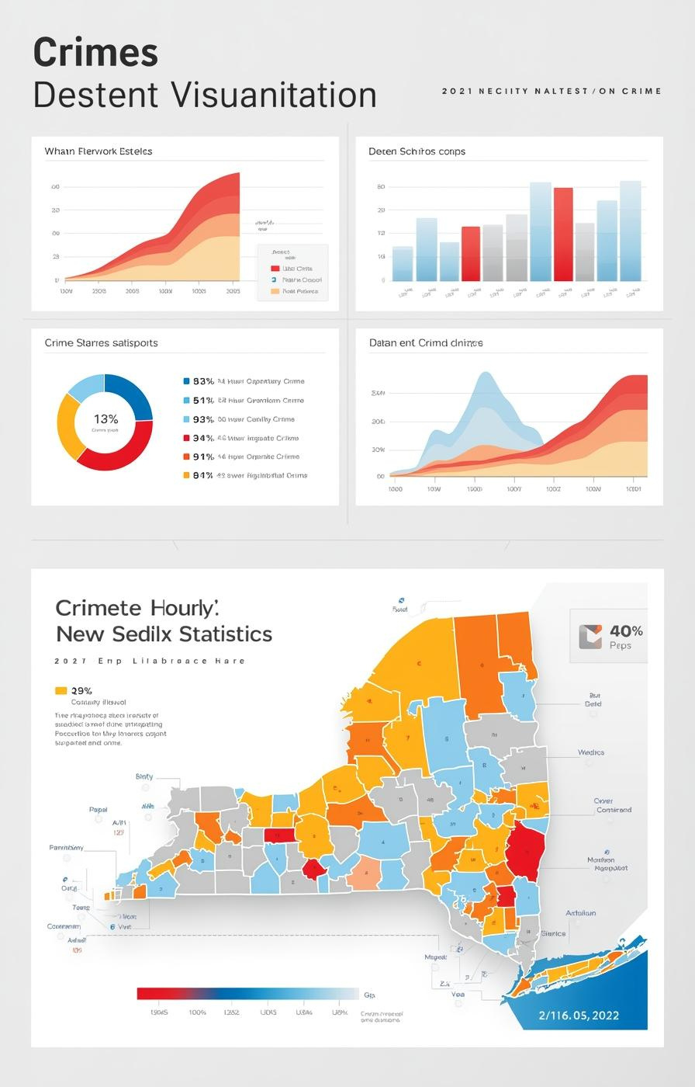

Data-Driven Hotspot Identification
Team 09 Vidhi Komal Aniket

Slide 2

Presentation Overview
Welcome
Purpose
Importance
We appreciate your presence today as we discuss an innovative approach to combat juvenile offender conversion through the identification of adult criminal hotspots in New York State.
This presentation aims to demonstrate how machine learning can efficiently identify critical areas with high adult criminal presence, ultimately guiding targeted interventions to reduce juvenile conversions.
Understanding these hotspots is essential for us as a team, as it allows for informed decisions and effective resource allocation to improve community safety and well-being throughout New York State.
2

Slide 3
Understanding Hotspot Challenges
Offenders and Criminal Rates
3

Slide 4
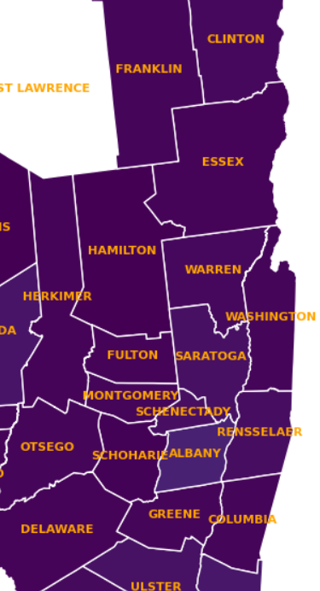
Adult Criminal Rates
The map illustrates adult criminal rates across New York counties, revealing significant variations. This data underscores the link between high adult crime presence and juvenile offender conversion, highlighting areas needing targeted intervention.

Slide 5
Machine Learning Solution
Data-driven hotspot classification overview
Key Features
Model Benefits
Transformative Insights
The model utilizes various data sources, including adult criminal counts and demographics, to identify patterns indicative of hotspots where interventions are most needed.
This approach ensures high accuracy and scalability, allowing for efficient identification of hotspots while uncovering hidden relationships within the data for targeted interventions.
By employing advanced machine learning techniques, we can generate actionable insights that guide effective policy-making and resource allocation in addressing juvenile conversion rates.
5

Slide 6



Key Features and Benefits
Accuracy
Scalability
Uncovering Hidden Patterns
The model achieves high accuracy by analyzing diverse data sources and patterns effectively.
This solution can efficiently handle increased data volumes without sacrificing performance or accuracy.
The model discovers hidden correlations in data, revealing insights for targeted interventions effectively.

Slide 7
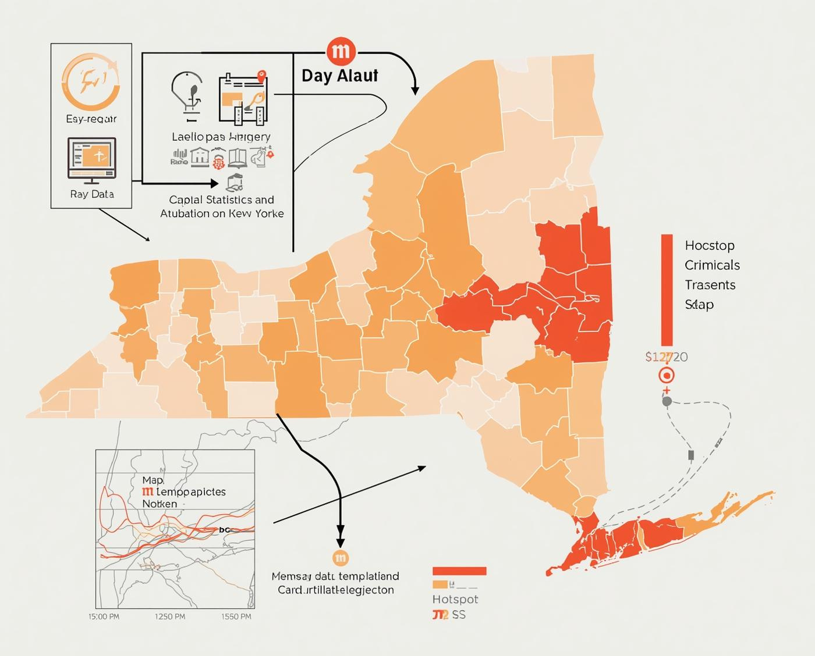
Workflow of Data to Hotspot Classification
Visualizing Data Transformation Process
Understanding the machine learning workflow

Slide 8
Solution Transparency and Reliability
01
Model Interpretability
Our machine learning model is designed to be user-friendly, providing clear insights into how features influence hotspot classification, ensuring all of us are able understand its decisions and rationale.
02
Data Integrity
We prioritize data accuracy through rigorous validation processes, ensuring that the information used is reliable, fostering trust in the findings and their implications for policy-making.

Slide 9
Targeted Policy Measures
Insights Guide Resource Allocation Strategies
Community Programs
Increased Monitoring
Education and Rehabilitation
Implementing community programs focused on youth engagement can effectively prevent juvenile conversion by providing positive environments and mentorship opportunities to at-risk individuals.
Enhancing monitoring in identified hotspots allows for early intervention, helping authorities to address rising adult criminal activity before it escalates and impacts the youth.
Promoting education and rehabilitation efforts within hotspots can break the cycle of crime, equipping individuals with the skills necessary for successful reintegration into society.
9

Slide 10
Recommended Strategies for Hotspots
01
Community Programs
03
Education
Foster local engagement through targeted initiatives.
Provide resources to raise awareness and prevention.
02
Monitoring
04
Rehabilitation
Implement regular assessments to track progress effectively.
Enhance support systems for juvenile offenders' reintegration.

Slide 11

Suggested Implementation Strategies and Benefits
Implementing targeted interventions can lead to:
Reduced juvenile-to-adult criminal conversion rates
Improved public safety and community stability
Increased trust and collaboration between law enforcement and communities
Enhanced resource allocation towards effective community programs
Long-term strategies focused on education and rehabilitation efforts
This proposed roadmap includes phases for initial analysis, community engagement, program rollout, and ongoing monitoring to assess impact and adapt strategies as necessary. This structured approach ensures that interventions remain effective and responsive to community needs, facilitating continuous improvement in public safety outcomes.

Slide 12


Thank You!

